Slide 1
Evaluating Solution

Slide 2
Why bother evaluating our solution?
Evaluating Solution
Learning Objective(s)
This material should address the following question(s).
How to evaluate a solution?

Slide 3
Discussion Point
Why bother evaluating our solution?

Slide 4
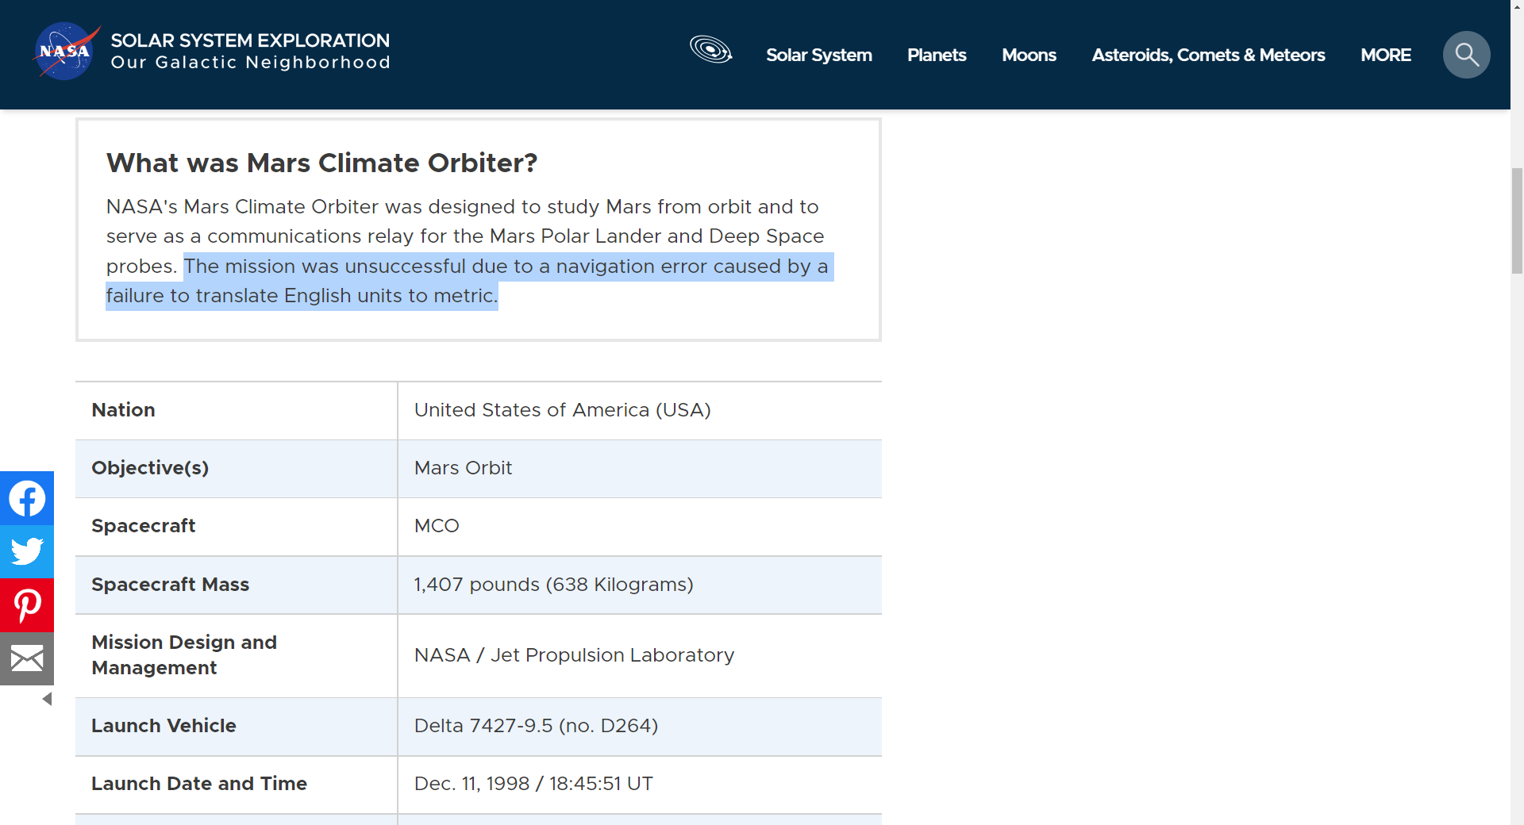

https://solarsystem.nasa.gov/missions/mars-climate-orbiter/in-depth/
https://youtu.be/lcYkOh4nweE

Slide 5
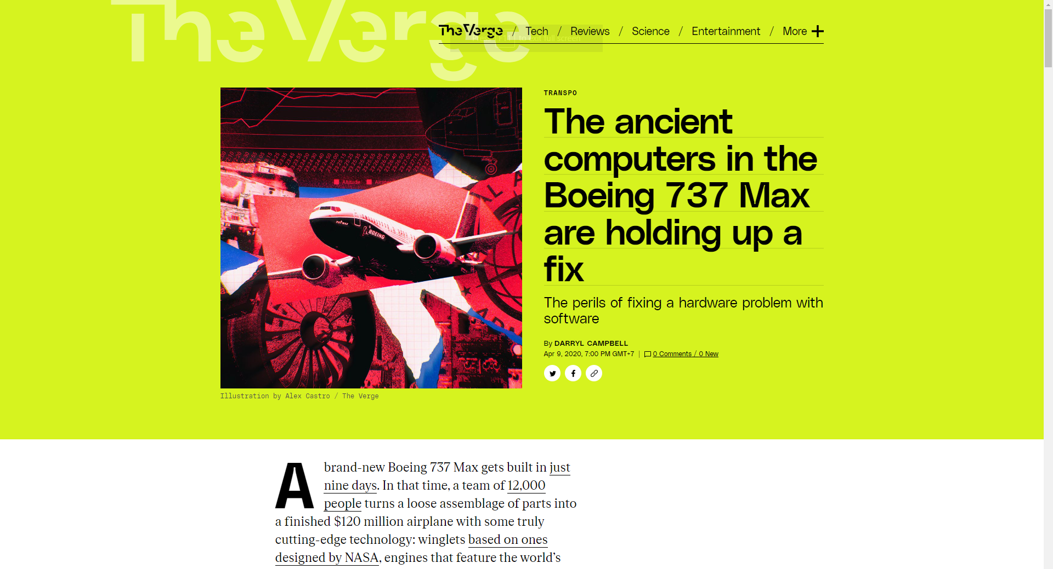
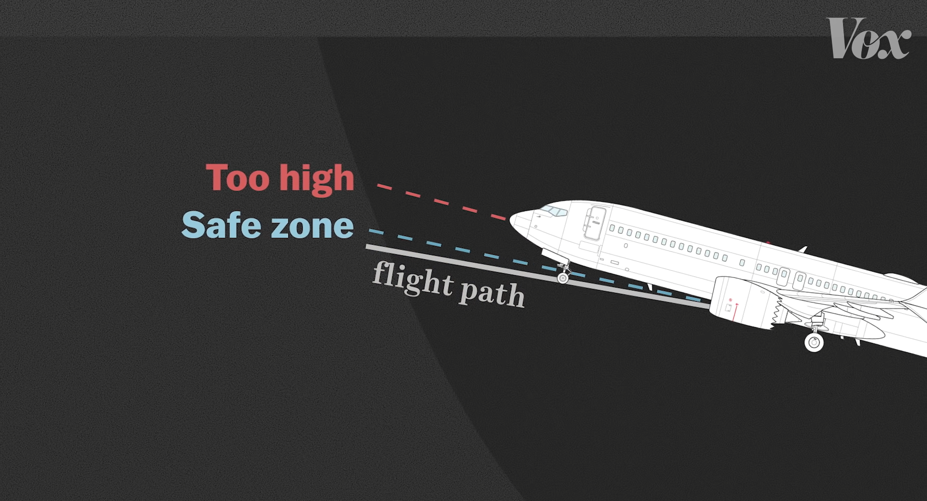
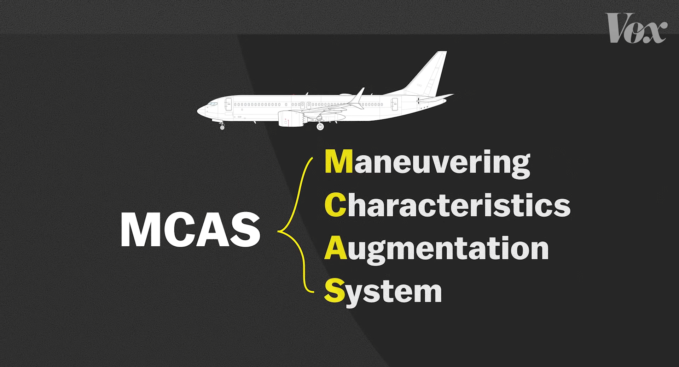
https://youtu.be/H2tuKiiznsY
https://www.theverge.com/2020/4/9/21197162/boeing-737-max-software-hardware-computer-fcc-crash

Slide 6
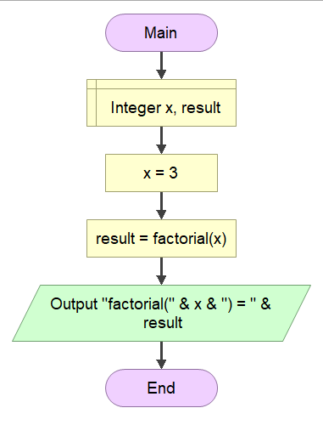
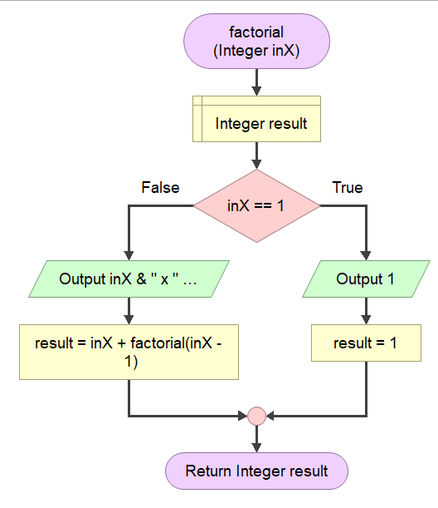
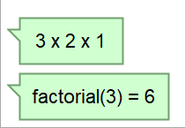
Base case
Recursive call
An ineffective factorial

Slide 7

The Take Away
In practice, a perfect solution is simply a myth.
Bugs (faults) are always lurking.
They will make failures during the software operational.
Minimizing the occurrence of bugs in the solution.

Slide 8
Software Fault
In a solution (software), a fault (bug) is an incorrect routine. When it is executed, the solution will very likely behave unexpectedly. Sometimes, it is life threatening.
A set of tests procedure should take place to reveal faults.

Slide 9
Discussion Point
Evaluating Solution: Testing.

Slide 10

Testing
It is a process of comparing the reality with the expectation.
It can show the presence of failures, not their absence.

Slide 11

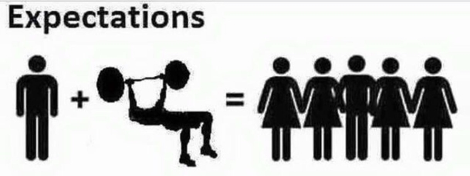
compare
equal?
passed
failed
Match the expectation.
Unlike expectation.
Basic testing process

Slide 12
Final Thoughts.

Slide 13
Conclusion
Our solution may contain faults (bugs).
An executed fault, failures, brings consequences.
Some consequences may severe.
A way to find out the existence of failures (faults) is by conducting enough testing.

Slide 14
References
Wassberg, J. (2020). Computer Programming for Absolute Beginners. Packt.

